Slide 1
Being a Reflective Practitioner – for IT Professionals (ICT302)
Dr Umera Imtinan

Slide 2
Notes:
South Street
We acknowledge that Murdoch University is situated on the lands of the Whadjuk and Binjareb Noongar people.
We pay our respect to their enduring and dynamic culture and the leadership of Noongar elders past and present.
The boodjar (country) on which Murdoch University is located has for thousands of years, been a place of learning. We at Murdoch University are proud to continue this long tradition.

Slide 3
Reflective Practice
What is reflective practice?
Benefits and challenges
Readings and Resources (on LMS)
Frameworks and Models (Kolb’s, Gibb’s model, Shaun’s model)
Reflective writing
Assessment in this unit

Slide 4
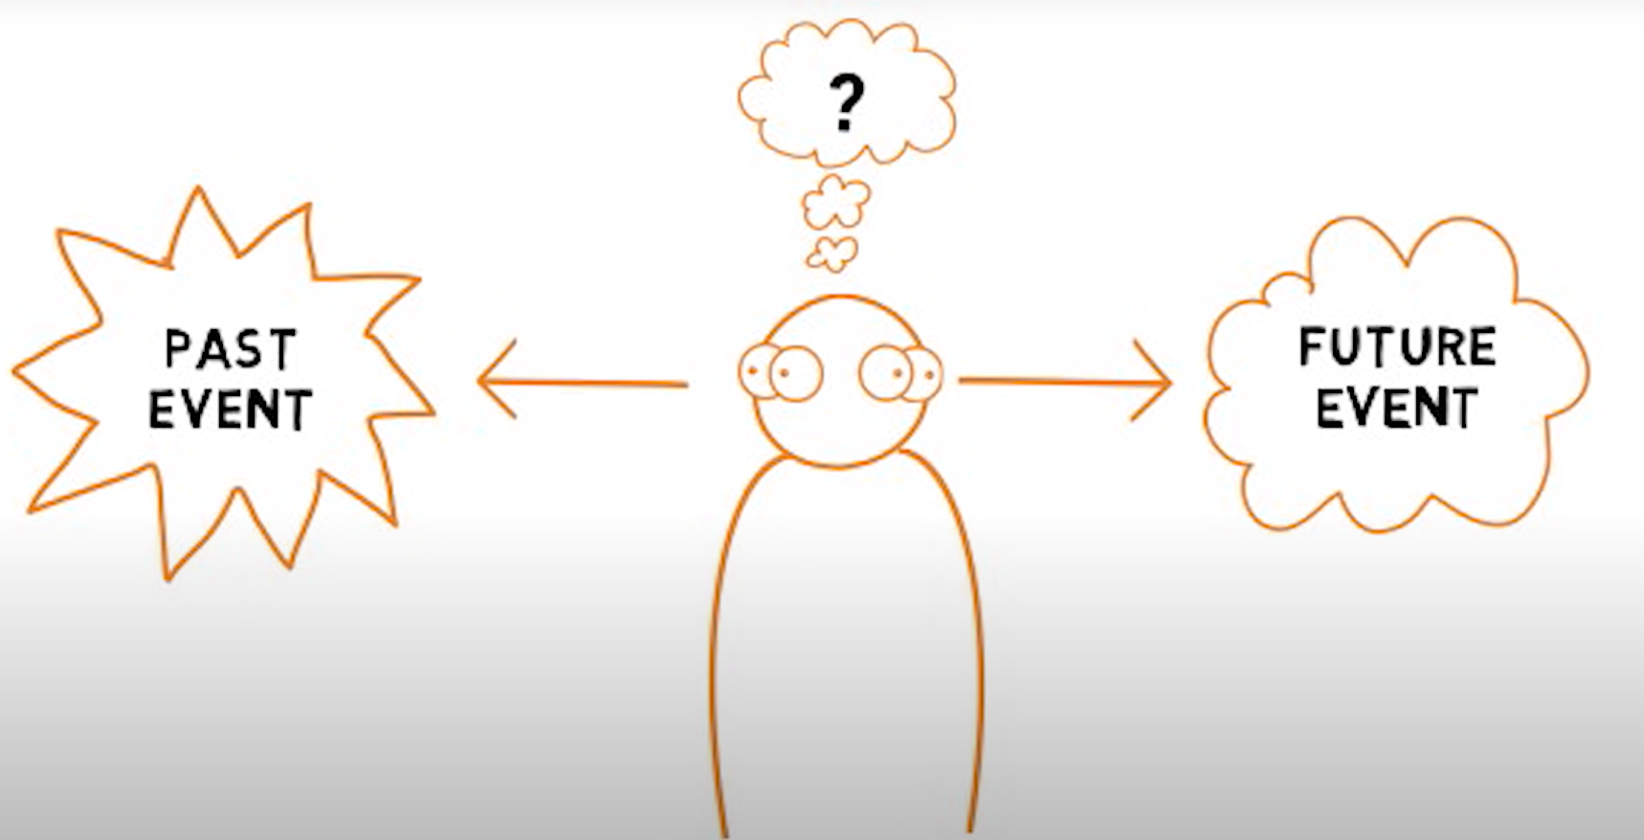
What is Reflection?

Slide 5

What is Reflective Practice?

Slide 6
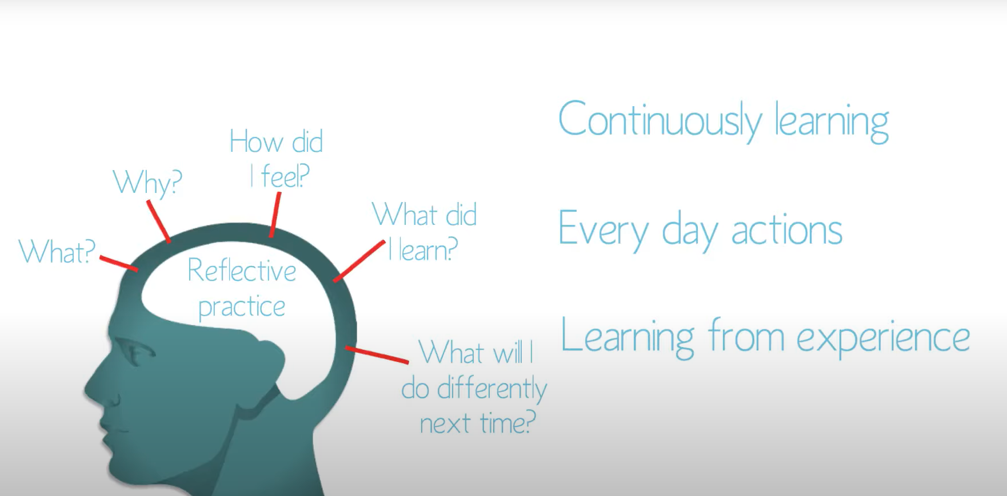
What is Reflective Practice?

Slide 7
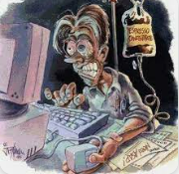
Why IT professionals need to be reflective practitioners?
I am a programmer, I have no life!
Image credit – internet

Slide 8
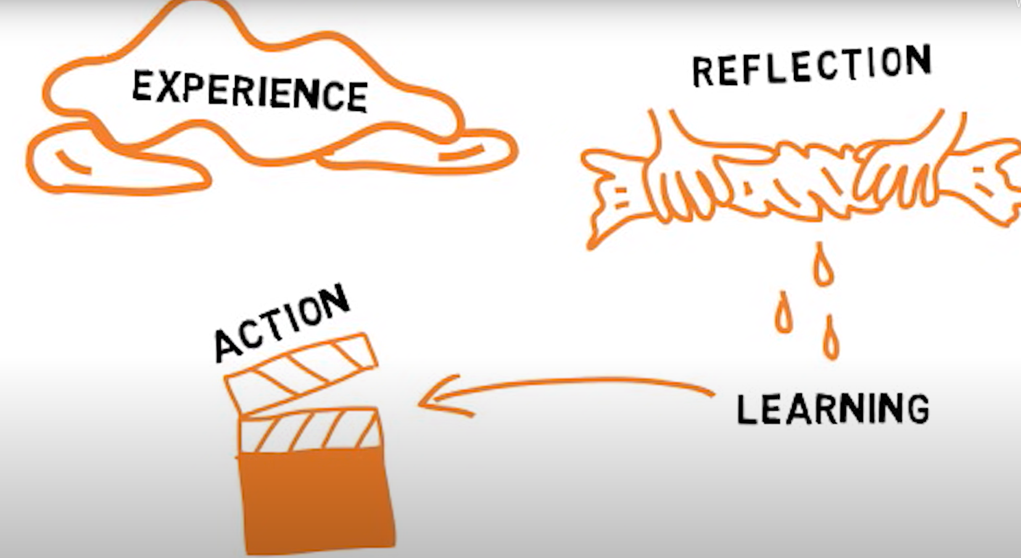
Why IT professionals need to be reflective practitioners?
Continuous professional learning
Change of technologies
Career planning and progression
Moving on to leadership roles
Looking after yourself

Slide 9
Models and Frameworks
Frameworks and Models (Kolb’s, Gibb’s model, Shaun’s model)
5 R (Reporting, Responding, Relating, Reasoning, Reconstructing)
STAR (Situation, Task, Action, Result)
STAR-L

Slide 10
Your reflection
Assessment in this unit
3 pieces across semester
2 peer evaluation
Prompts in the templates
Dates/weeks
How to submit?

Slide 11
References, readings and resources
Reflective practice toolkit
Understanding reflective practice - video (3 mins)
What is reflective practice - video (10 mins)
Reflective practice and writing for IT students and professionals
Examples of reflective writing
Acknowledgement – Most images in this slide deck have been taken from videos in this reference list.

